Slide 1
Data Cube Computation and Data Generalization

Slide 2
Efficient Computation of Data Cubes
Computing full/iceberg cubes: 3 methodologies
  Top-Down: Multi-Way array aggregation
  Bottom-Up:
    Bottom-up computation: BUC
    H-cubing technique
  Integrating Top-Down and Bottom-Up:
    Star-cubing algorithm High-dimensional OLAP: A Minimal Cubing Approach
Computing alternative kinds of cubes:
  Partial cube, closed cube, approximate cube, etc.

Slide 3
Preliminary Tricks
Sorting, hashing, and grouping operations are applied to the dimension attributes in order to reorder and cluster related tuples
Aggregates may be computed from previously computed aggregates, rather than from the base fact table
  Smallest-child: computing a cuboid from the smallest, previously computed cuboid
  Cache-results: caching results of a cuboid from which other cuboids are computed to reduce disk I/Os
  Amortize-scans: computing as many as possible cuboids at the same time to amortize disk reads
  Share-sorts: sharing sorting costs cross multiple cuboids when sort-based method is used
  Share-partitions: sharing the partitioning cost across multiple cuboids when hash-based algorithms are used

Slide 4
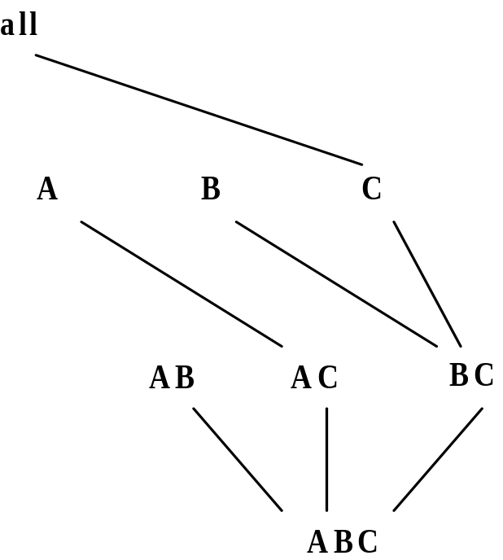
Multi-Way Array Aggregation
Array-based “bottom-up” algorithm
Using multi-dimensional chunks
No direct tuple comparisons
Simultaneous aggregation on multiple dimensions
Intermediate aggregate values are re-used for computing ancestor cuboids
Cannot do Apriori pruning: No iceberg optimization

Slide 5
Multi-way Array Aggregation for Cube Computation (MOLAP)
Partition arrays into chunks (a small subcube which fits in memory).
Compressed sparse array addressing: (chunk_id, offset)
Compute aggregates in “multiway” by visiting cube cells in the order which minimizes the # of times to visit each cell, and reduces memory access and storage cost.
C
c3
61
62
63
64
c2
45
46
47
48
c1
29
30
31
32
What is the best traversing order to do multi-way aggregation?
c 0
B
60
b3
13
14
15
16
44
9
28
56
b2
B
40
24
52
b1
5
36
20
b0
1
2
3
4
a0
a1
a2
a3
A

Slide 6
Multi-way Array Aggregation for Cube Computation
C
c3
61
62
63
64
c2
45
46
47
48
c1
29
30
31
32
c 0
B
60
b3
13
14
15
16
44
B
9
28
56
b2
40
5
24
52
b1
36
20
b0
1
2
3
4
a0
a1
a2
a3
A

Slide 7
Multi-way Array Aggregation for Cube Computation
C
c3
61
62
63
64
c2
45
46
47
48
c1
29
30
31
32
c 0
B
60
b3
13
14
15
16
44
B
9
28
56
b2
40
5
24
52
b1
36
20
b0
1
2
3
4
a0
a1
a2
a3
A

Slide 8
Multi-Way Array Aggregation for Cube Computation (Cont.)
Method: the planes should be sorted and computed according to their size in ascending order
  Idea: keep the smallest plane in the main memory, fetch and compute only one chunk at a time for the largest plane
Limitation of the method: computing well only for a small number of dimensions
  If there are a large number of dimensions, “top-down” computation and iceberg cube computation methods can be explored

Slide 9
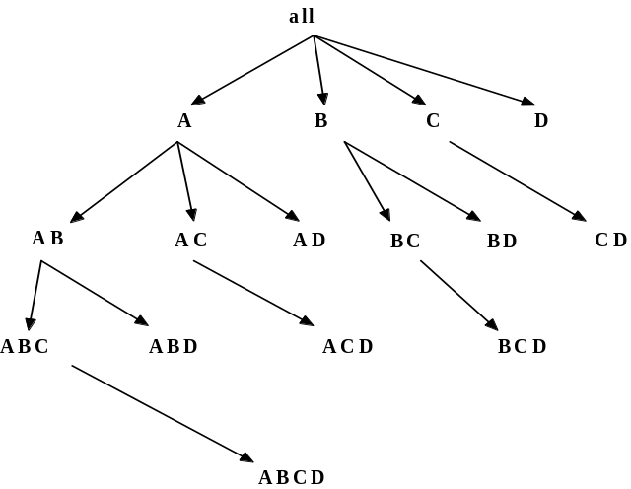
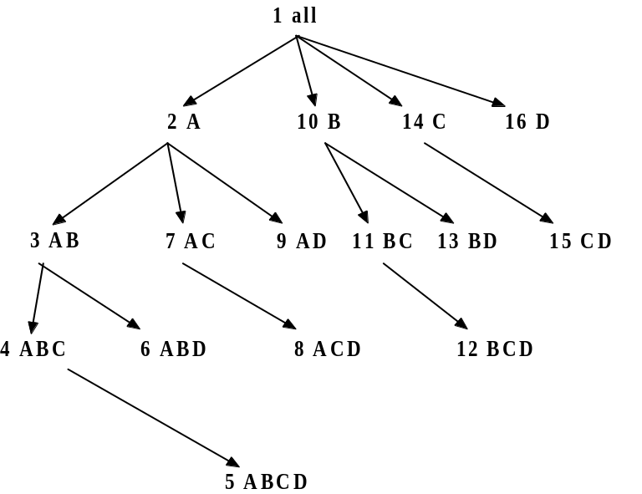
Bottom-Up Computation (BUC)
Bottom-up cube computation
  (Note: top-down in our view!)
Divides dimensions into partitions and facilitates iceberg pruning
  If a partition does not satisfy min_sup, its descendants can be pruned
  If minsup = 1 ⇒ compute full CUBE!
No simultaneous aggregation

Slide 10

BUC: Partitioning
Usually, entire data set can’t fit in main memory
Sort distinct values, partition into blocks that fit
Continue processing
Optimizations
  Partitioning
    External Sorting, Hashing, Counting Sort
  Ordering dimensions to encourage pruning
    Cardinality, Skew, Correlation
  Collapsing duplicates
    Can’t do holistic aggregates anymore!

Slide 11
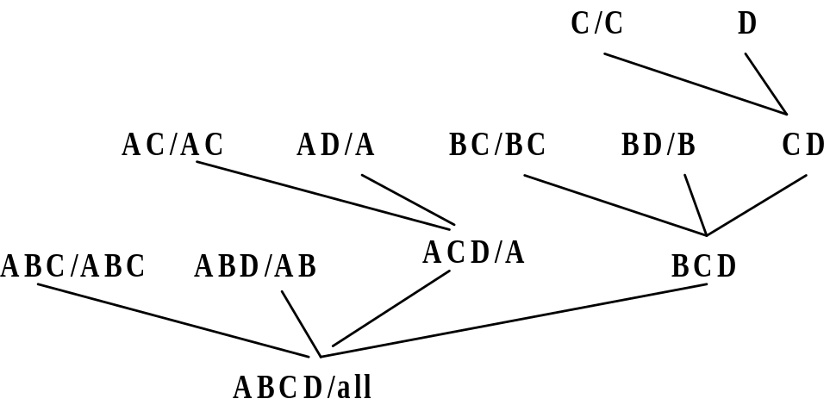
Star-Cubing: An Integrating Method
Integrate the top-down and bottom-up methods
Explore shared dimensions
  E.g., dimension A is the shared dimension of ACD and AD
  ABD/AB means cuboid ABD has shared dimensions AB
Allows for shared computations
  e.g., cuboid AB is computed simultaneously as ABD
Aggregate in a top-down manner but with the bottom-up sub-layer underneath which will allow Apriori pruning
Shared dimensions grow in bottom-up fashion

Slide 12
Iceberg Pruning in Shared Dimensions
Anti-monotonic property of shared dimensions
  If the measure is anti-monotonic, and if the aggregate value on a shared dimension does not satisfy the iceberg condition, then all the cells extended from this shared dimension cannot satisfy the condition either
Intuition: if we can compute the shared dimensions before the actual cuboid, we can use them to do Apriori pruning
Problem: how to prune while still aggregate simultaneously on multiple dimensions?

Slide 13
Multi-Way Star-Tree Aggregation
Start depth-first search at the root of the base star tree
At each new node in the DFS, create corresponding star tree that are descendents of the current tree according to the integrated traversal ordering
The counts in the base tree are carried over to the new trees
When DFS reaches a leaf node , start backtracking
On every backtracking branch, the count in the corresponding trees are output, the tree is destroyed, and the node in the base tree is destroyed
Notes:
Refer to the aggregation diagram.

Slide 14
Motivation of High-D OLAP
Challenge to current cubing methods:
  The “curse of dimensionality’’ problem
  Iceberg cube and compressed cubes: only delay the inevitable explosion
  Full materialization: still significant overhead in accessing results on disk
High-D OLAP is needed in applications
  Science and engineering analysis
  Bio-data analysis: thousands of genes
  Statistical surveys: hundreds of variables

Slide 15
What is Concept Description?
Descriptive vs. predictive data mining
  Descriptive mining: describes concepts or task-relevant data sets in concise, summarative, informative, discriminative forms
  Predictive mining: Based on data and analysis, constructs models for the database, and predicts the trend and properties of unknown data
Concept description:
  Characterization: provides a concise and succinct summarization of the given collection of data
  Comparison: provides descriptions comparing two or more collections of data

Slide 16
Data Generalization and Summarization-based Characterization
Data generalization
  A process which abstracts a large set of task-relevant data in a database from a low conceptual levels to higher ones.
  Approaches:
    Data cube approach(OLAP approach)
    Attribute-oriented induction approach
1
2
3
4
Conceptual levels
5

Slide 17
Concept Description vs. OLAP
Similarity:
  Data generalization
  Presentation of data summarization at multiple levels of abstraction.
  Interactive drilling, pivoting, slicing and dicing.
Differences:
  Can handle complex data types of the attributes and their aggregations
  Automated desired level allocation.
  Dimension relevance analysis and ranking when there are many relevant dimensions.
  Sophisticated typing on dimensions and measures.
  Analytical characterization: data dispersion analysis

Slide 18
Attribute-Oriented Induction
How it is done?
  Collect the task-relevant data (initial relation) using a relational database query
  Perform generalization by attribute removal or attribute generalization
  Apply aggregation by merging identical, generalized tuples and accumulating their respective counts
  Interactive presentation with users

Slide 19
Basic Principles of Attribute-Oriented Induction
Data focusing: task-relevant data, including dimensions, and the result is the initial relation
Attribute-removal: remove attribute A if there is a large set of distinct values for A but (1) there is no generalization operator on A, or (2) A’s higher level concepts are expressed in terms of other attributes
Attribute-generalization: If there is a large set of distinct values for A, and there exists a set of generalization operators on A, then select an operator and generalize A
Attribute-threshold control: typical 2-8, specified/default
Generalized relation threshold control: control the final relation/rule size

Slide 20
Attribute-Oriented Induction: Basic Algorithm
InitialRel: Query processing of task-relevant data, deriving the initial relation.
PreGen: Based on the analysis of the number of distinct values in each attribute, determine generalization plan for each attribute: removal? or how high to generalize?
PrimeGen: Based on the PreGen plan, perform generalization to the right level to derive a “prime generalized relation”, accumulating the counts.
Presentation: User interaction: (1) adjust levels by drilling, (2) pivoting, (3) mapping into rules, cross tabs, visualization presentations.

Slide 21
Presentation of Generalized Results
Generalized relation:
  Relations where some or all attributes are generalized, with counts or other aggregation values accumulated.
Cross tabulation:
  Mapping results into cross tabulation form (similar to contingency tables).
  Visualization techniques:
  Pie charts, bar charts, curves, cubes, and other visual forms.
Quantitative characteristic rules:
  Mapping generalized result into characteristic rules with quantitative information associated with it

Slide 22
Mining Class Comparisons
Comparison: Comparing two or more classes
Method:
  Partition the set of relevant data into the target class and the contrasting class(es)
  Generalize both classes to the same high level concepts
  Compare tuples with the same high level descriptions
  Present for every tuple its description and two measures
    support - distribution within single class
    comparison - distribution between classes
  Highlight the tuples with strong discriminant features
Relevance Analysis:
  Find attributes (features) which best distinguish different classes

Slide 23
Summary
Efficient algorithms for computing data cubes
  Multiway array aggregation
  BUC
  H-cubing
  Star-cubing
  High-D OLAP by minimal cubing
Further development of data cube technology
  Discovery-drive cube
  Multi-feature cubes
  Cube-gradient analysis
Another generalization approach: Attribute-Oriented Induction

